Slide 1
Introduction
Arcelor FullStack Developer

Slide 2

@kevinderudder
: Full-Stack developer
: Competence Manager

Slide 3
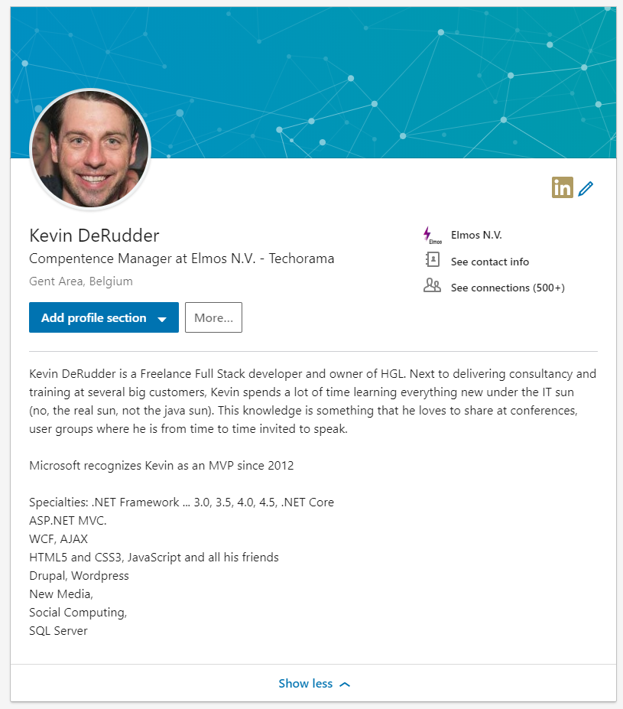

Slide 4
Who are you
Name
Role
Experience

Slide 5
Course starts at 9:00
Course ends at 16:45 – 17:00
Breaks
Morning break: 15min
Afternoon break: 15min
Lunch: 60min

